Slide 1

SWEN 755: Software Architecture
Achieving Qualities
Viktoria Koscinski
All rights reserved (M. Mirakhorli, V. Koscinski)

Slide 2
Tactics
Designing an architecture
Why is understanding qualities so important?
Customer wants a fast application
Hmmm… How fast it should be? In terms of what? Response time, latency, average latency, worst case latency, ???
Does the customer mean performance or usability?
Response time, throughput, capacity, ???
What about security and availability?
E.g., critical infrastructure
Notes:
Great!!! He wants fast recovery. But why the system is down? It was because of an attack or failure? Does it matter at all?
Recovery can happen after a failure or after an attack, they are similar but slightly different.

Slide 3
Tactics
Achieving Qualities
Qualities are typically achieved through architectural decisions – such as the use of architectural tactics, patterns and styles.
Definitions:
A tactic is a design decision that influences a quality attribute response (for a single QA).
Architectural patterns can be seen as “packages” of tactics.
System design is a collection of decisions.
Some decisions help control quality attribute responses.
Other decisions deliver system functionality.
Decisions about choice of technologies.
Decisions affecting developing process and organization.
Notes:
An architectural tactic is a design decision that affects a quality attribute
response. The focus of a tactic is on a single quality attribute response. Architectural
patterns can be seen as “packages” of tactics.
Most patterns consist of (are constructed from) several different tactics. (p. 204 – textbook)

Slide 4
Tactics
About Tactics
Tactics refine other tactics (i.e. hierarchy).
Tactics can be packaged in patterns.
Patterns have known properties that permit reuse and describe a class of architectures.
Tactics are the “building blocks”
We will look at examples of different tactics:
Availability
Performance
Security
Modifiability
Notes:
So the purpose of tactics is to achieve our quality attributes that we previously looked at in terms of scenarios.
Tactics are atoms and patterns are molecules.

Slide 5
Availability Tactics
Availability Tactics
1- Highly available? Is 90% OK?
2- Doesn’t crash at all???
3- Maybe it’s OK to crash sometimes
but recover quickly, right?
4- How can I know that it has crashed?
Customer wants a highly available system

Slide 6
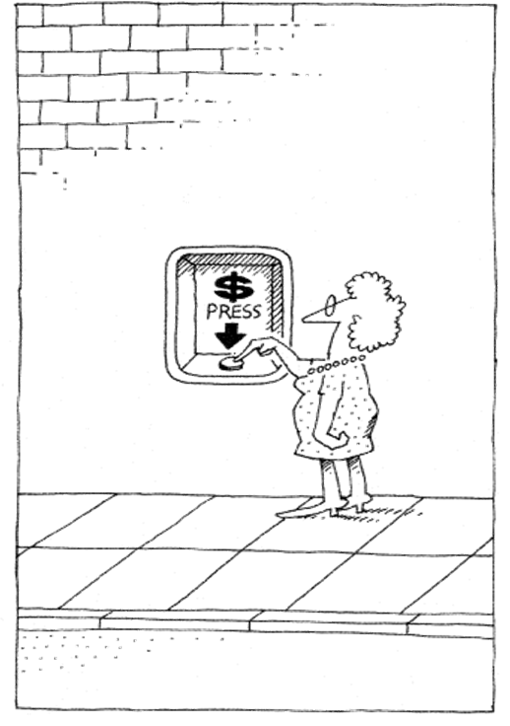
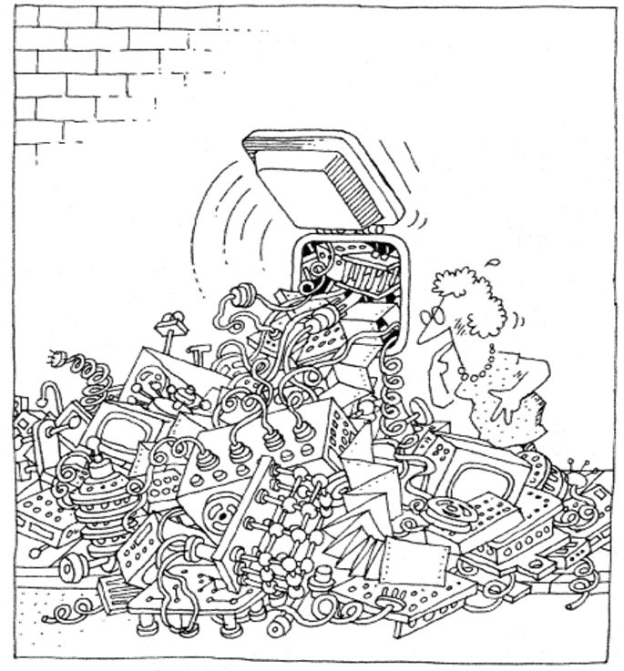
Availability Tactics
Availability Tactics
Purpose: To keep faults from becoming failures.

Slide 7
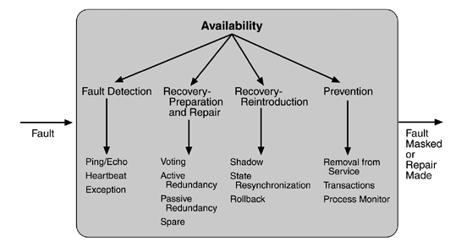
Availability Tactics
Availability Tactics

Slide 8
Fault Detection
Fault Detection
Heartbeat - I am alive!
Periodic message exchange between a system monitor and a process being monitored
Ping/Echo - Are you alive?
Asynchronous request/response message pair exchanged between nodes
Requires time threshold (how long until it “timed out”)
Exception - it died!
Detection of a system condition that alters the normal flow of execution
Notes:
The big difference between heartbeat and ping/echo is who holds the responsibility for initiating the health check—the monitor or the component itself.

Slide 9
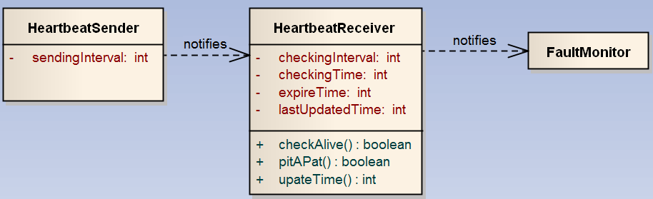
Fault Detection
Fault detection: Heartbeat tactic
Purpose: To allow processes to monitor availability of a critical component.
The HeartbeatSender sends a heartbeat message periodically.
The HeartbeatReceiver receives the heartbeat, updates the last received time of a heartbeat message is updated, which is captured by the updateTime() role.

Slide 10
Fault Detection
Fault detection: Heartbeat tactic
The aliveness of heartbeat sender is checked regularly by comparing the latency time between the current time and last updated time in consideration of the max waiting time for the next heartbeat message.
Sending heartbeat messages and checking aliveness are executed on separate threads for concurrency.
When a fault occurs, the fault should be recognized, and an exception handler should be informed of it. This is captured in the Exception tactic.

Slide 11
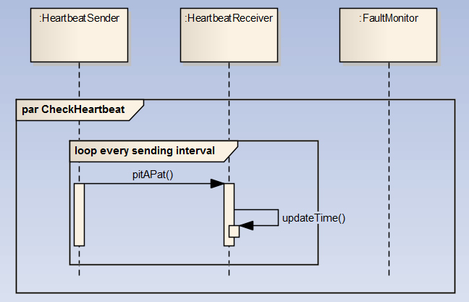
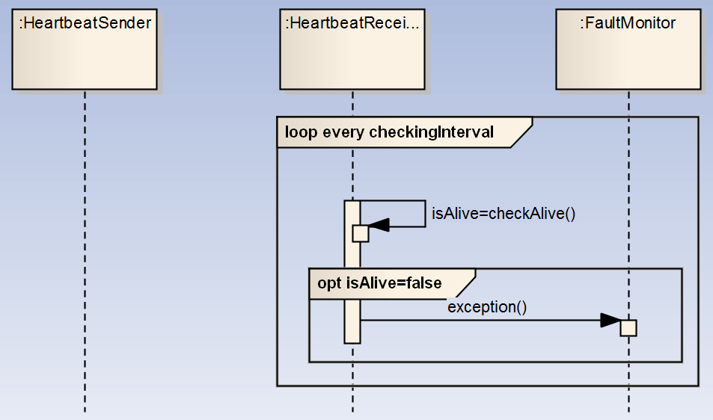
Fault Detection
Fault detection: Heartbeat tactic
Sequence diagram – two separate threads.

Slide 12
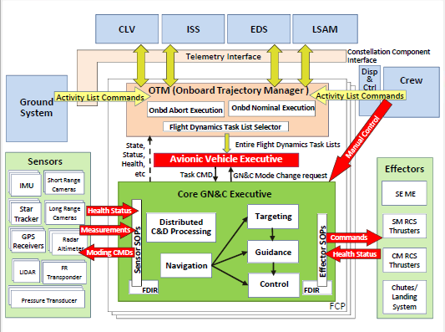
Fault Detection
Fault detection: Heartbeat tactic
NASA Crew Exploration Vehicle – Guidance-Navigation and Control (GN&C) Architecture
Error detection in the Voyager ACS is composed of the following:
• Failure of Command and Control Subsystem (CCS) to receive “I’m-Healthy” report every 2 seconds
Notes:
Error detection in the Voyager ACS is composed of the following:
• Failure of Command and Control Subsystem (CCS) to receive “I’m-Healthy” report every 2 seconds

Slide 13

Fault Detection
Fault detection: Heartbeat tactic

Slide 14
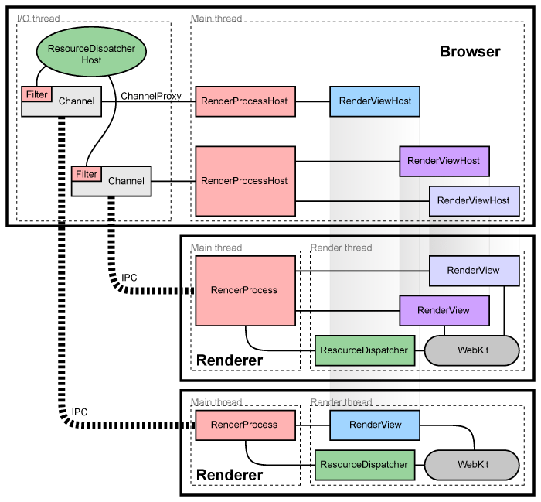
Fault Detection
Fault detection: Heartbeat tactic

Slide 15
Fault Detection
Fault detection: Ping/Echo tactic
Purpose: One component issues a ping and expects to receive back an echo within a predefined time.
Asynchronous request/response message pair exchanged between nodes.
Used to determine reachability and the round-trip delay through the associated network path.
Standard implementations of Ping/Echo are available for nodes interconnected via IP
ICMP 7 [IETF 1981] or ICMPv6[RFC 2006b] Echo Request/Response[IETF 2006a].

Slide 16
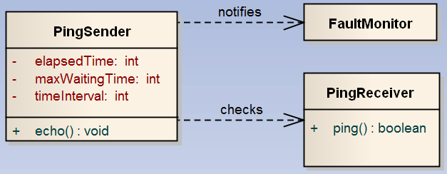
Fault Detection
Fault detection: Ping/Echo tactic
PingSender sends a ping message at specified timeIntervals and waits for an echo from a ping receiver until the maxWaitingTime. If an echo is not received an exception occurs, and it is detected by the fault monitor.
Notes:
In this case, where is the safety critical component?

Slide 17
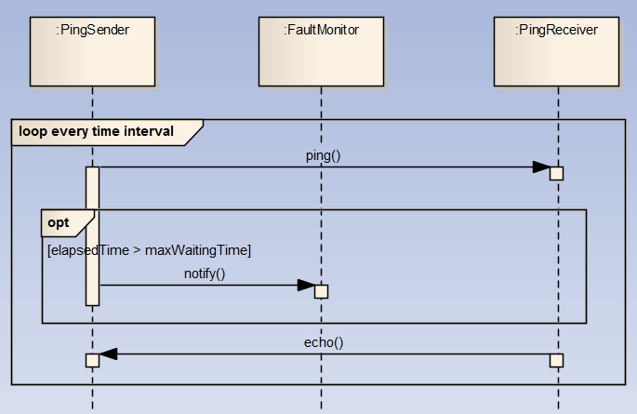
Fault Detection
Fault detection: Ping/Echo tactic
(Software version)
Notes:
Sequence diagram

Slide 18
Fault Detection
Fault detection: Ping/Echo tactic
Ping echo has been used to check the health of actuators.
Sensors periodically send data, so the heartbeat tactic is an appropriate choice.
Actuators are passive (they mainly execute commands) so ping echo is a better option.
NASA Crew Exploration Vehicle – Guidance-Navigation and Control (GN&C) Architecture
Notes:
Ping echo has been used to check the health of actuators.
Sensors periodically send data so heartbeat tactic is an appropriate choice, while actuators are passive they mainly execute commands so ping echo is a better option.

Slide 19
Fault Detection
Assignment 1
Select a domain.
Develop a critical process (with minimum functionality).
Design a non-deterministic failure in this process which makes it crash.
Implement heartbeat to monitor the process.
Your heartbeat implementation should have all the required fault detection features.
Rule 1: Do not embed a failure, it must be random and it must cause failure.
Rule 2: Implement functions on different processes.
Rule 3: Select a relevant domain: monitoring connections, monitoring process, …
Constraints: Languages limited to Java, C#. You can use the existing frameworks or implement from scratch.
Notes:
Non-deterministic: same input can lead to various outputs.
Previous assignment domains:
“Nuclear watchdog” program – watchdog will crash if “reactor” reaches a critical temp, but only x% of the time
Transaction processor program – gets a divide by zero every so often.
“Industrial printer” program sends stuff to print but will fail if there’s a jam or a printer goes offline.
Android data packet sender over UDP.

Slide 20
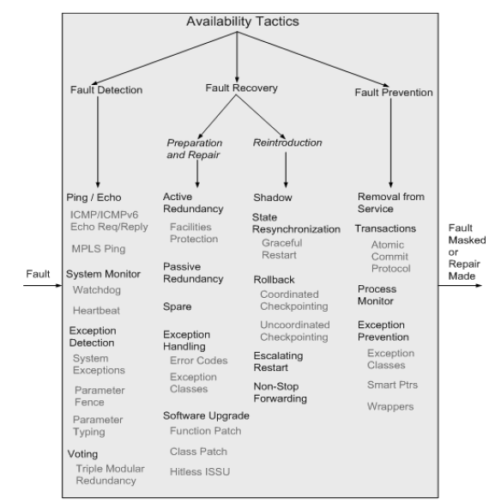
Fault Recovery
Fault Recovery:

Slide 21
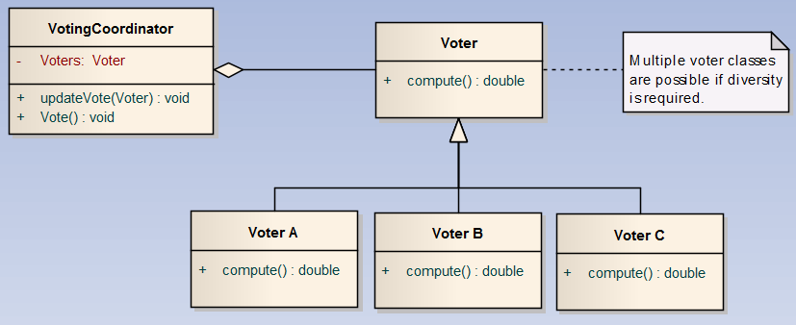
Fault Recovery
Fault Recovery: Voting
Purpose: Processes running on redundant processors each take equivalent input and compute a simple output value that is sent to a voter.
The basic Voting tactic uses redundancy for recovery preparation. Multiple processes are run and results are compared using a voting strategy.

Slide 22
Fault Recovery
Fault Recovery: Voting
Voting is essential for supporting redundancy.
The Voting fault detection tactic is based on the fundamental contributions to automata theory by Von Neumann, who demonstrated how systems having a prescribed reliability could be built from unreliable components [Von Neumann 1956].
Example:
Assume a fault rate on a single component of ε_{e} = 0.001
Redundancy level = 3
Majority voting scheme is used.
Failure rate = 0.000002998 How?

Slide 23
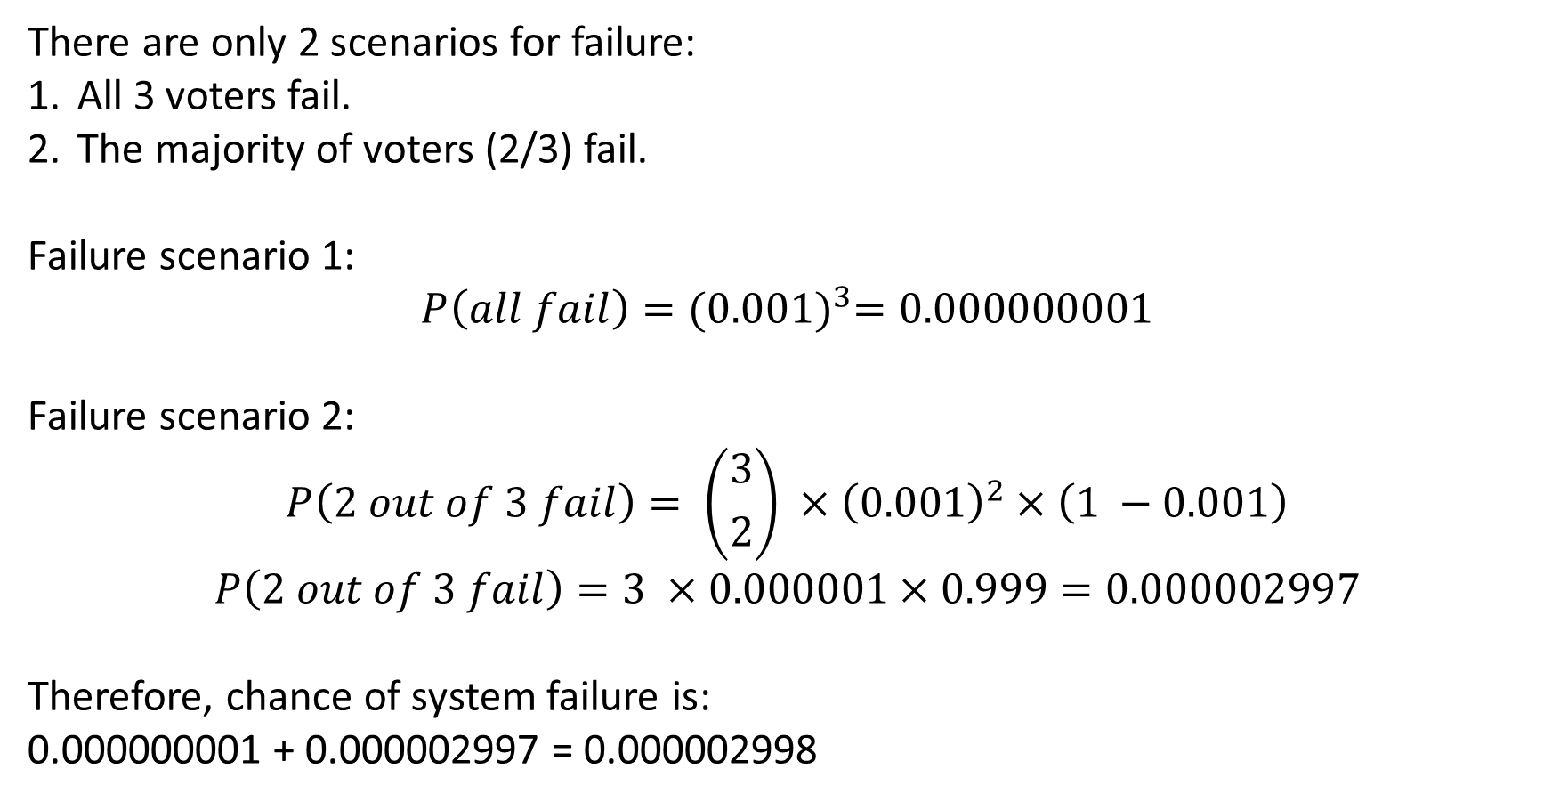
Fault Recovery
Fault Recovery: Voting
There are only 2 scenarios for failure:
All 3 voters fail.
The majority of voters (2/3) fail.
Failure scenario 1:
$$P\left(all fail\right)={(0.001)}^{3}=0.000000001$$
Failure scenario 2:
$$P\left(2 out of 3 fail\right)= \left({3 \atop 2}\right) ×{\left(0.001\right)}^{2}×\left(1 −0.001\right)$$
$$P\left(2 out of 3 fail\right)=3 ×0.000001×0.999=0.000002997$$
Therefore, chance of system failure is:
0.000000001 + 0.000002997 = 0.000002998
Notes:
In scenario 2, the first variable is the binomial coefficient for selecting 2 out of 3 components, the second variable is the probability that 2 components fail, and the third variable is the probability that one component works.

Slide 24
Fault Recovery
Fault Recovery: Voting
Coordination mechanisms
Majority rules – 2/3, etc.
Preferred component – assume a particular voter is correct
Computed average
Voter diversity
Same algorithm → processor/hardware failure only
Diverse algorithm → processor and algorithmic failure
Diversity can be EXPENSIVE
http://www.youtube.com/watch?v=gp_D8r-2hwk
Notes:
There are a few ways voting can be implemented.
Same algorithm -> hardware failure; not design or implementation errors
Diverse algorithm -> addresses design or implementation errors in hardware or software components

Slide 25
Fault Detection
Fault Recovery: Voting
Error detection in the Voyager ACS is composed of the following:
Failure of Command and Control Subsystem (CCS) to receive “I’m-Healthy” report every 2 seconds
NASA Crew Exploration Vehicle – Guidance-Navigation and Control (GN&C) Architecture

Slide 26
Fault Recovery
Fault recovery: redundancy
Definition: A protection group is a group of processing nodes where one or more nodes are “active” with the remaining nodes in the protection group serving as redundant spares.
The simple case of one active node and one redundant spare node is commonly referred to as 1+1 (“one plus one”) redundancy.
Redundancy types:
Active redundancy (Hot sparing)
Passive redundancy (Warm sparing)
Sparing (Cold Sparing)
Notes:
Active redundancy (hot spare). This refers to a configuration where all of the nodes (active or redundant spare) in a protection group receive and process identical inputs in parallel, allowing the redundant spare(s) to maintain synchronous state with the active node(s). Because the redundant spare possesses an identical state to the active processor, it can take over from a failed component in a matter of milliseconds. (1+1 is active)
Passive redundancy (warm spare). This refers to a configuration where only the active members of the protection group process input traffic; one of their duties is to provide the redundant spare(s) with periodic state updates. passive redundancy provides a solution that achieves a balance between the more highly available but more compute-intensive (and expensive) active redundancy tactic and the less available but significantly less complex cold spare tactic (which is also significantly cheaper).
Spare (cold spare). Cold sparing refers to a configuration where the redundant spares of a protection group remain out of service until a fail-over occurs, at which point a power-on-reset procedure is initiated on the redundant spare prior to its being placed in service. Good for reliability but bad for availability.

Slide 27
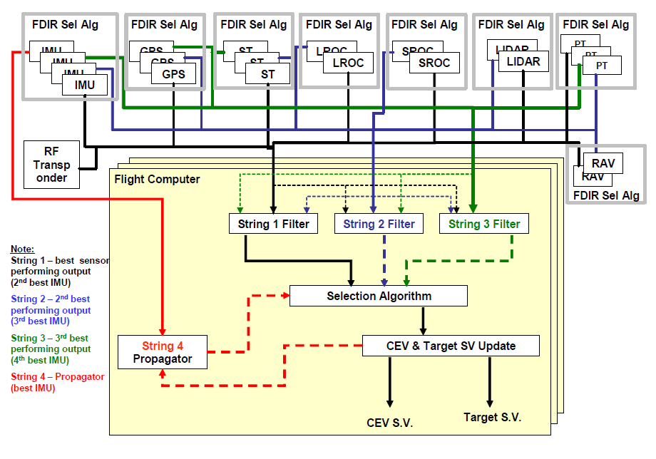
Redundancy management architecture example
Notes:
https://core.ac.uk/download/pdf/10535667.pdf

Slide 28
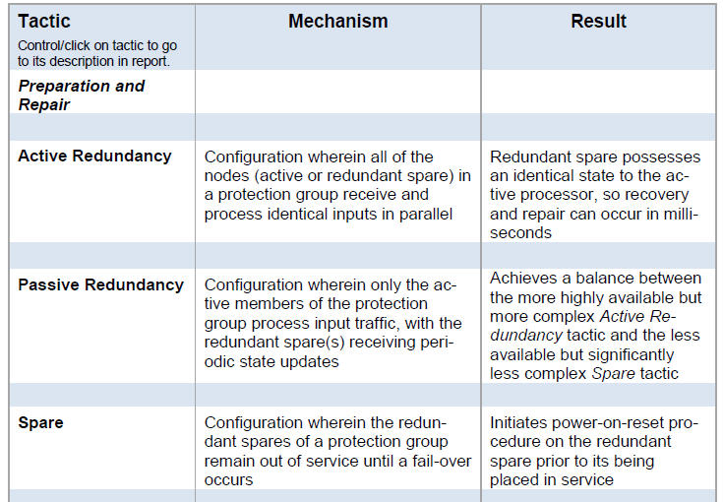
Fault Recovery
Fault recovery: redundancy
Notes:
Here is just a table showing the same thing.

Slide 29
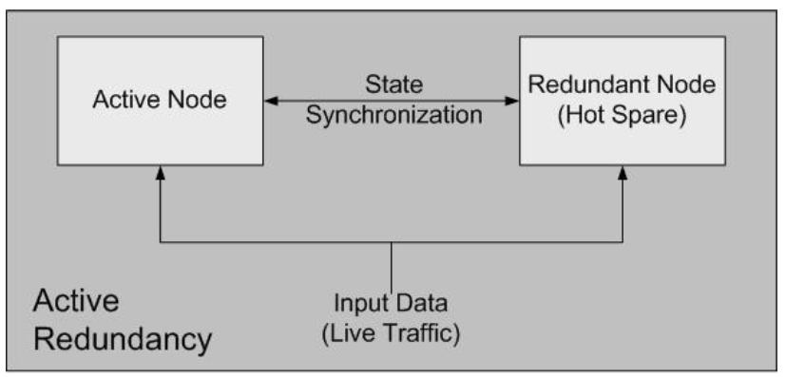
Fault Recovery
Fault Recovery: Active Redundancy
Purpose: (hot sparing) . Multiple systems maintained in identical state so that any one can be used.
All redundant components respond to events in parallel and are therefore maintained in the same state.
Only one response is used (usually first responder), others are discarded.
When faults occurs, downtime is usually in milliseconds.

Slide 30
Fault Recovery
Fault Recovery: Active Redundancy
Redundancy can be either at the processor level or the communication path (i.e., a single path failure will not make all components inaccessible).
Standards: for protecting network links (i.e., facilities) at the physical layer [Bellcore 1998, 1999, Telcordia 2000][IETF 2005].

Slide 31
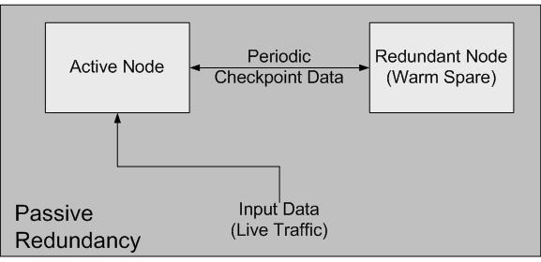
Fault Recovery
Fault Recovery: Passive Redundancy
Purpose: (warm sparing). One component responds to events and informs the standby components of state updates they must make.

Slide 32
Fault Recovery
Fault Recovery: Passive Redundancy
When a fault occurs, the system must check that backup state is sufficiently fresh.
Considerations:
Which component decides when the secondary component should take over from the primary one?
Some systems constantly switch between primary and secondary components. Why?
Checkpointing: How tightly coupled are primary and secondary components?

Slide 33
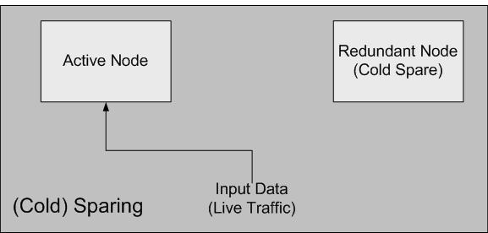
Fault Recovery
Fault Recovery: Sparing
Purpose: (Cold sparing). A standby spare computing platform is configured to replace failed components.
The redundant spares of a protection group remain out of service until a fail-over occurs, at which point a Power-On-Reset procedure is initiated on the redundant spare prior to its being placed in service.
Must be rebooted when a failure occurs.
State must be refreshed before spare goes online.
Downtime usually measured in minutes.
More suited for systems with ONLY high reliability (MTBF) as opposed to high availability requirements.
Notes:
MTBF = mean time between failure

Slide 34
Fault Recovery
Fault Recovery: Reintroduction
Shadow operation: Previously failed component is run in “shadow” mode to make sure it performs acceptably before being re-introduced.
State resynchronization: Both passive and active redundancy tactics require a component being restored to have its state synchronized.
Checkpoint/rollback:
Checkpoint is a recording of a consistent state created periodically or in response to specific events.
System restoration sometimes needs to be made from a consistent checkpoint.
Notes:
Resynchronization:
Occurs naturally in active redundancy, why? Because the active and standby components process identical inputs in parallel
In passive, based on periodic state information (checkpointing)

Slide 35
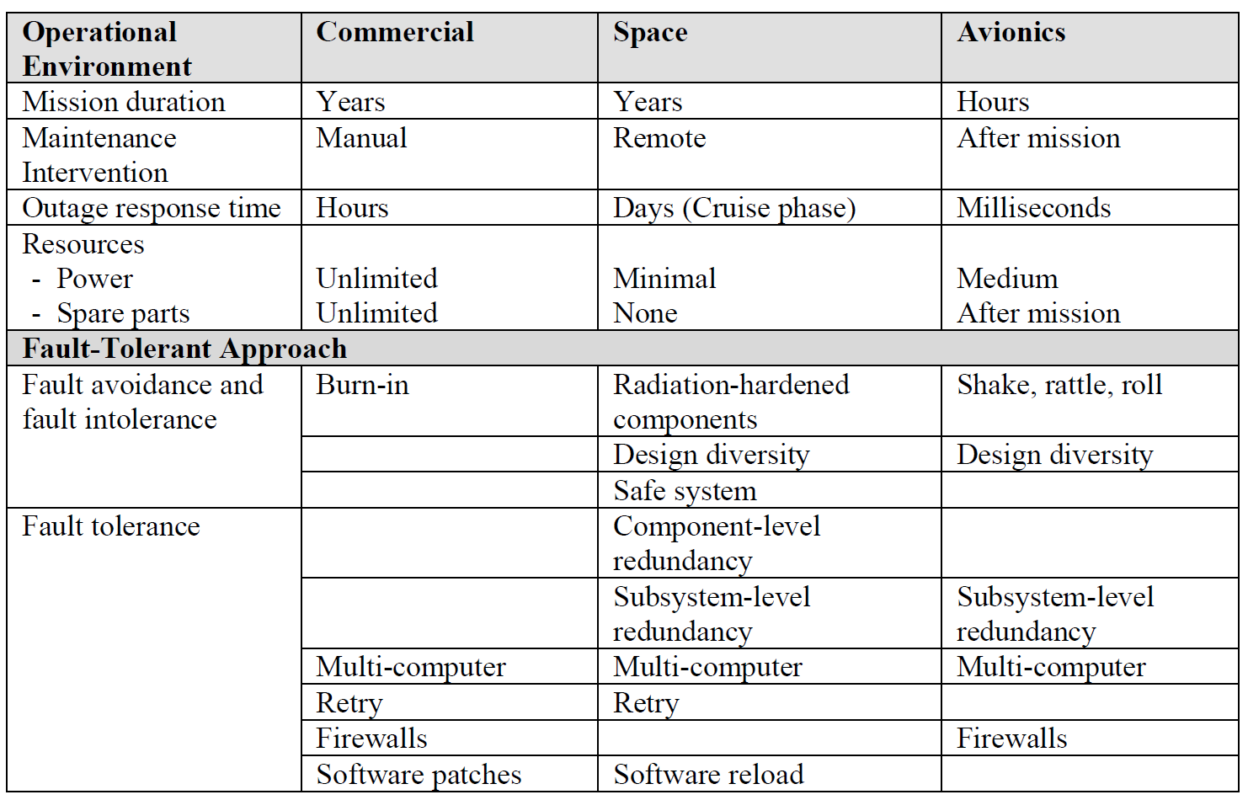
Class Activity
Fault Tolerance
Comparison of the commercial, space and avionics domains

Slide 36
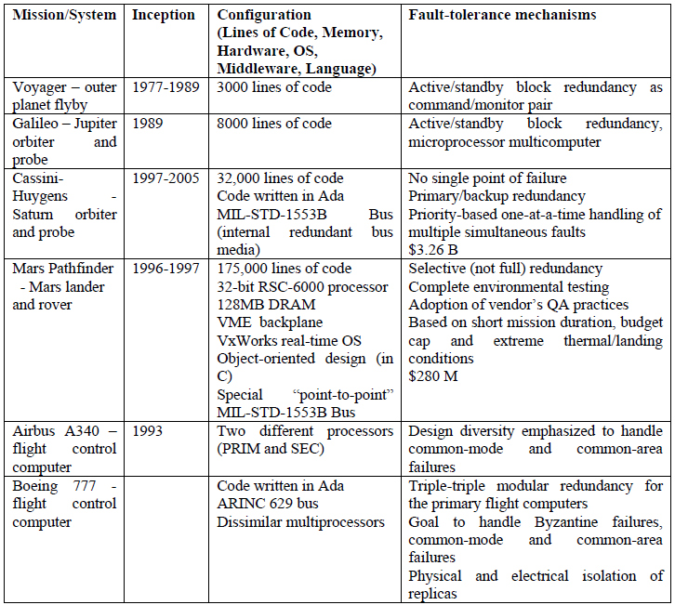
Class Activity
Fault tolerance mechanisms for specific spacecraft & aircraft

Slide 37

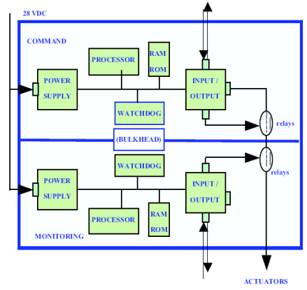
Airbus A340
- N-Self Checking as logic
- Multiple FC
- Each FC uses logical redundancy (Single Processor)
Notes:
The Airbus flight control system uses a “2-Self Checking Programming” as the voting mechanism‎[27]. This includes two software units (command and monitoring unit) which also receive identical inputs. The units are located on a single processor but run on separate operating system processes. The results generated by the command unit are compared to those of the monitoring unit and if they do not match airplane control is switched to another computer.

Slide 38

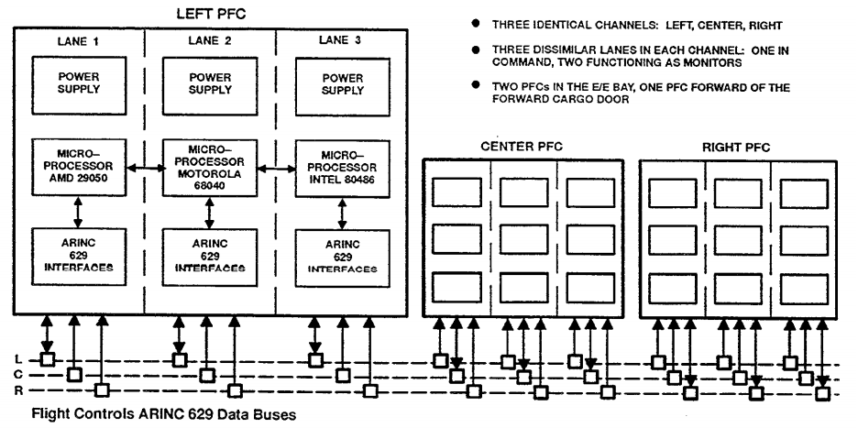
Boeing 777
Notes:
More specifically, the likelihood of loss of aircraft function or critical failure must be less than 10⁻⁹ per flight hour
In the Boeing 777 the Primary Flight Control (PFC) system has three replicated software modules, each of which is deployed on a separate processor‎[24]. Each of the PFCs receives the same input values from which they independently compute output values. The results are then evaluated using a “majority” voting algorithm.
In contrast, The Airbus flight control system uses a “2-Self Checking Programming” as the voting mechanism‎[27]. This includes two software units (command and monitoring unit) which also receive identical inputs. The units are located on a single processor but run on separate operating system processes. The results generated by the command unit are compared to those of the monitoring unit and if they do not match airplane control is switched to another computer.
In the Airbus case, the architect selected logical redundancy by proposing a multi threading approach but in the Boeing case it was decided to deploy them to different processors in order to increase the level of availability and reliability.

Slide 39
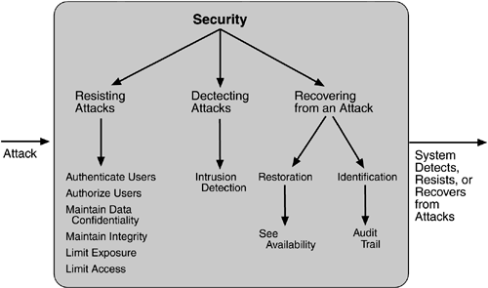
Class Activity
Security Tactics
More than hundreds of variances of tactics
Notes:
Next time, each person gives a short 2-min overview of each of these.

Slide 40
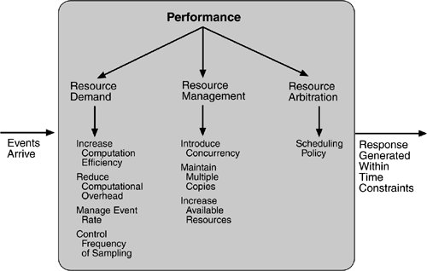
Class Activity
Performance Tactics

Slide 41
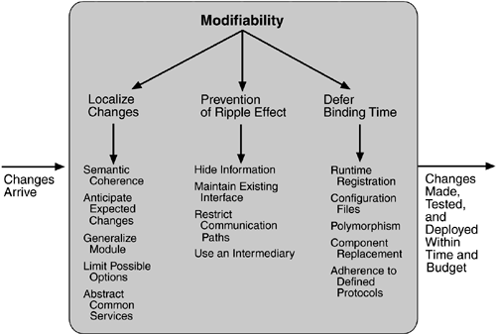
Class Activity
Modifiability Tactics

Slide 42
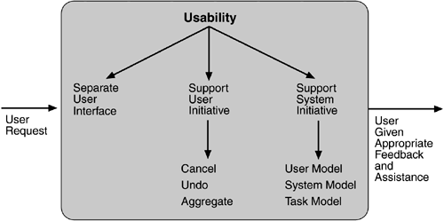
Class Activity
Usability Tactics
Ease of Use
Ease of learning
Efficient
Error Tolerant

Slide 43
Software architecture design
Designing Software Architecture
How to drive the structure of the systems
Based on Functional Requirements:
Similar functionalities in a same module. E.g. banking system: account management, managing cash distribution, cash collection, transaction records, tracking system.
Reference Models
Existing Assets
Legacy systems, COTS, reused design
Architectural Decisions
Client-Server Approach
Constraints
Notes:
COTS == commercial off the shelf

Slide 44
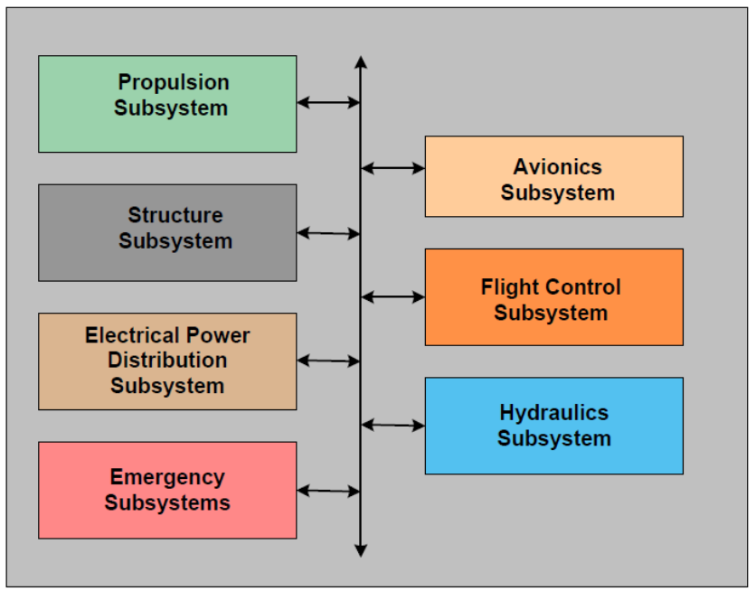
Software architecture design
Designing Software Architecture
Avionic Systems Reference Models

Slide 45
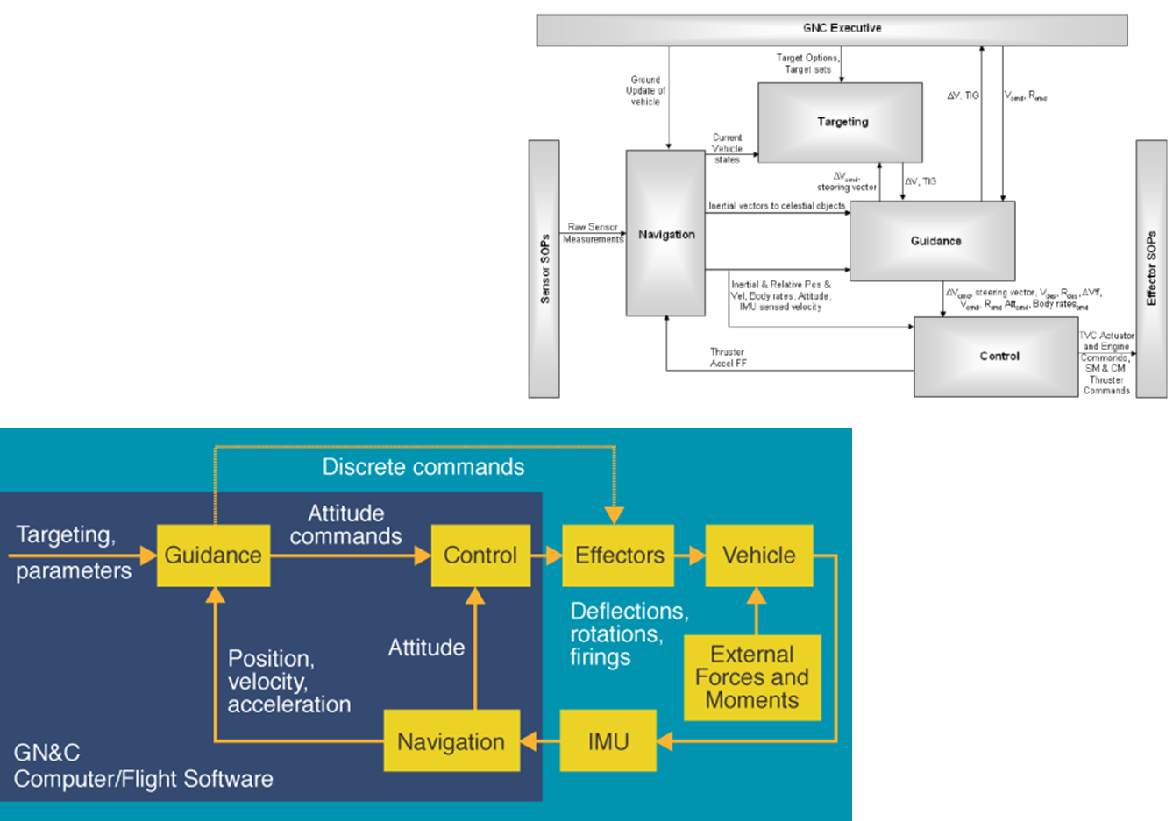
Software architecture design
Designing Software Architecture
Flight Control System
GNC Reference Model

Slide 46
Software architecture design
Designing Software Architecture
Guidance
Guidance refers to the determination of the desired path of travel (the "trajectory") from the vehicle's current location to a designated target, as well as desired changes in velocity, rotation and acceleration for following that path.
Navigation
Navigation refers to the determination, at a given time, of the vehicle's location and velocity (the "state vector") as well as its altitude.
Control
Control refers to the manipulation of the forces, by way of steering controls, thrusters, etc., needed to track guidance commands while maintaining vehicle stability.
GNC systems
GNC systems are found in essentially all autonomous or semi-autonomous systems. These include:
Autopilots
Driverless cars, like Mars rovers or those participating in the DARPA Grand Challenge
Guided missiles
precision-guided airdrop systems
Reaction control systems for spacecraft
Spacecraft launch vehicles.

Slide 47
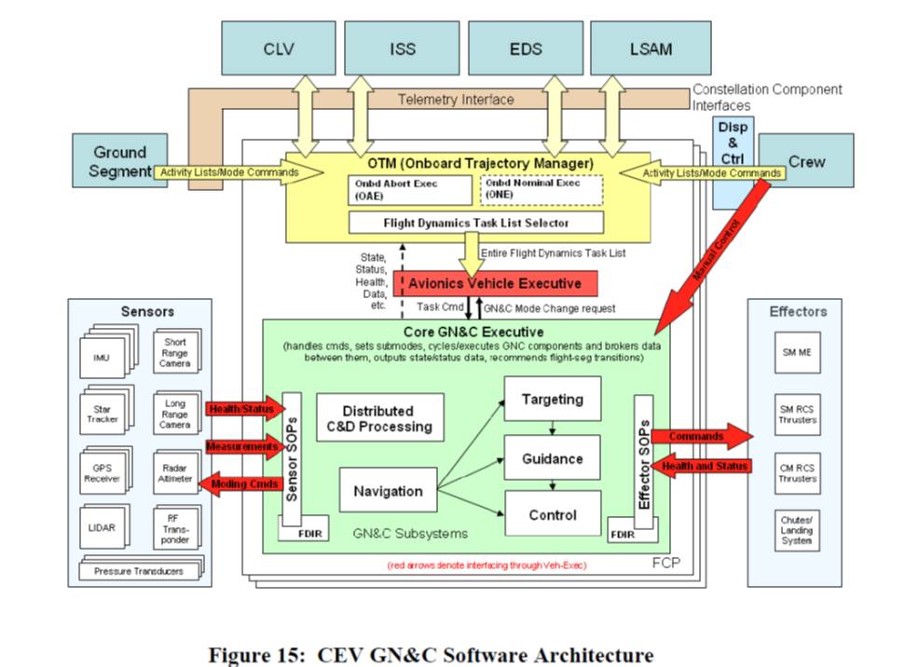
Software architecture design
Designing Software Architecture
NASA Lunar System

